Slide 1
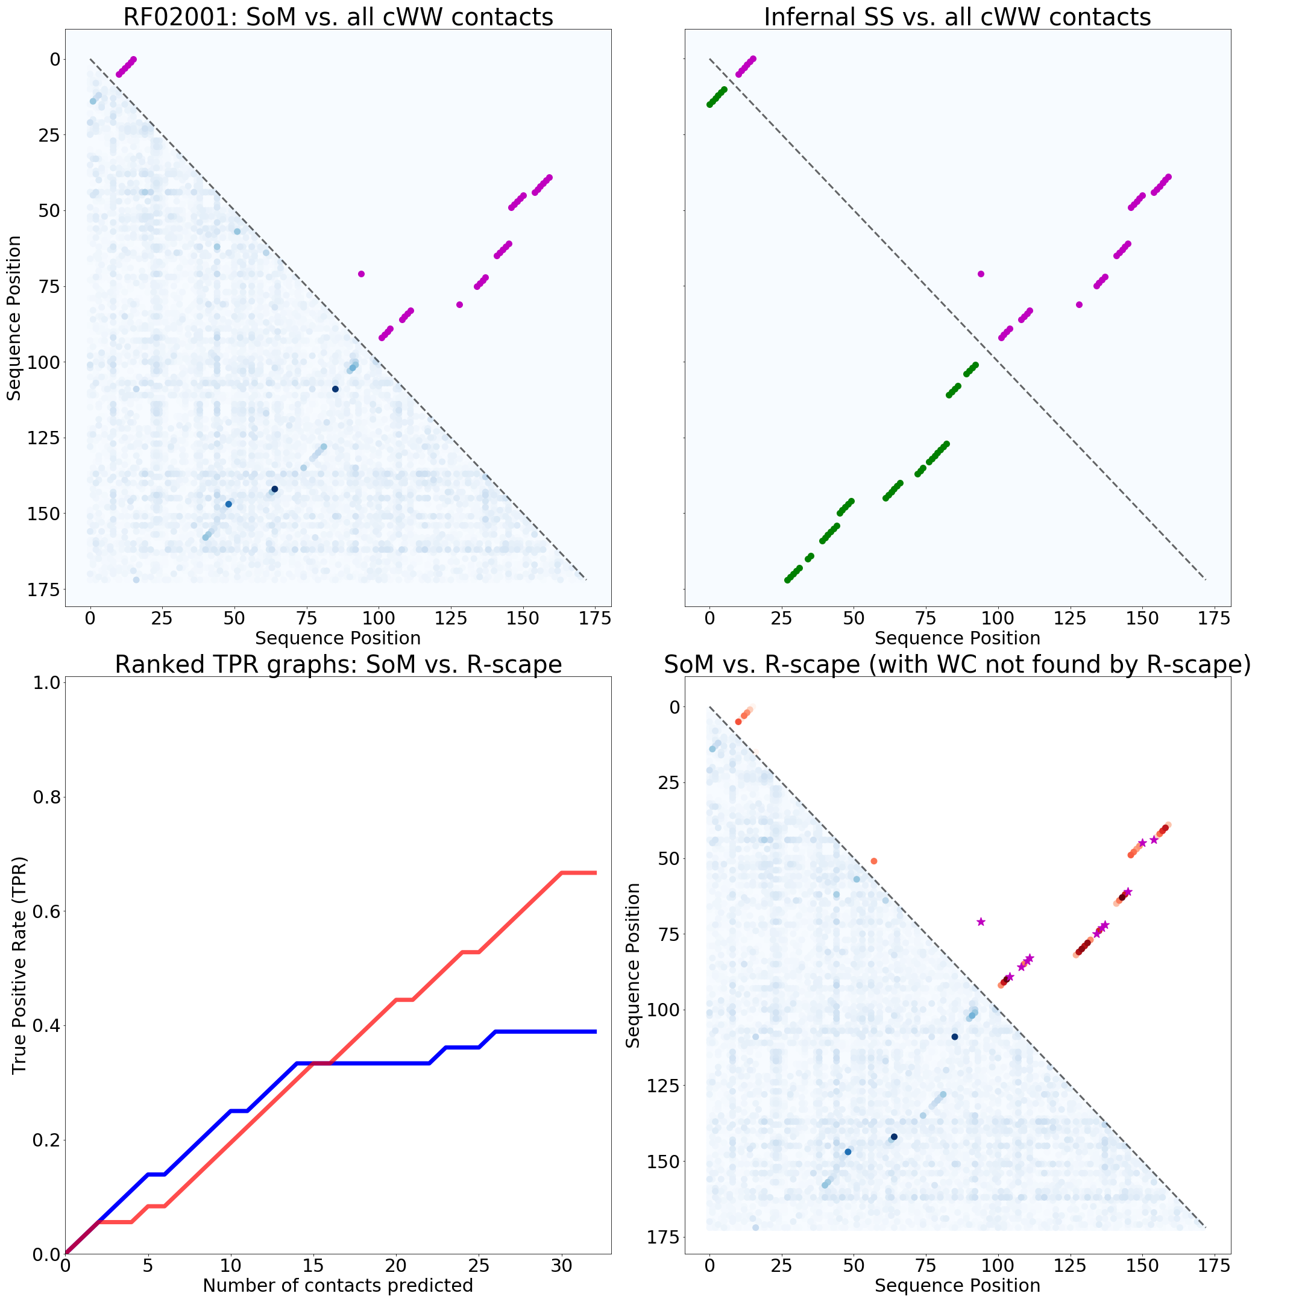
RF00017 - Metazoan signal recognition particle RNA

